Slide 1
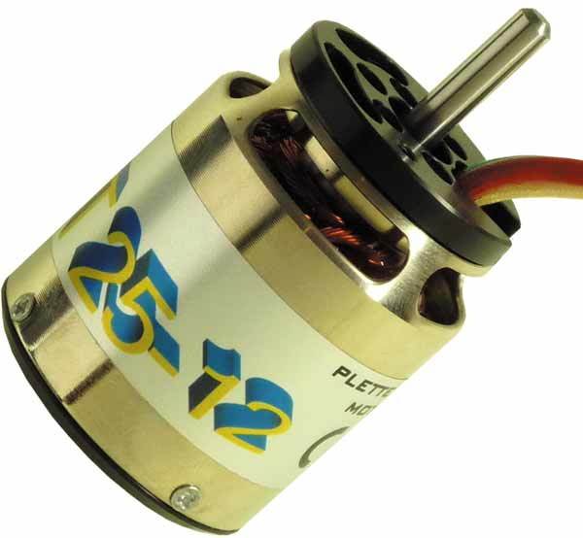
BRUSHLESS DC MOTORS
And How to Drive Them

Slide 2
Why The BLDC Motor
Also called brushless Permanent Magnet DC (BLDC) or synchronous DC motor
Advantages :
􀂾 High efficiency (up to 96%)
􀂾 Variable speed
􀂾 Silent operation
􀂾 Reliable/long life time (no brushes)
􀂾 High Power/ Size ratio
􀂾 High torque at start-up

Slide 3
Disadvantages :
􀂾 Requires complex drive cirquit
􀂾 High cost
􀂾 Permanent magnets can be demagnetized at high temp

Slide 4
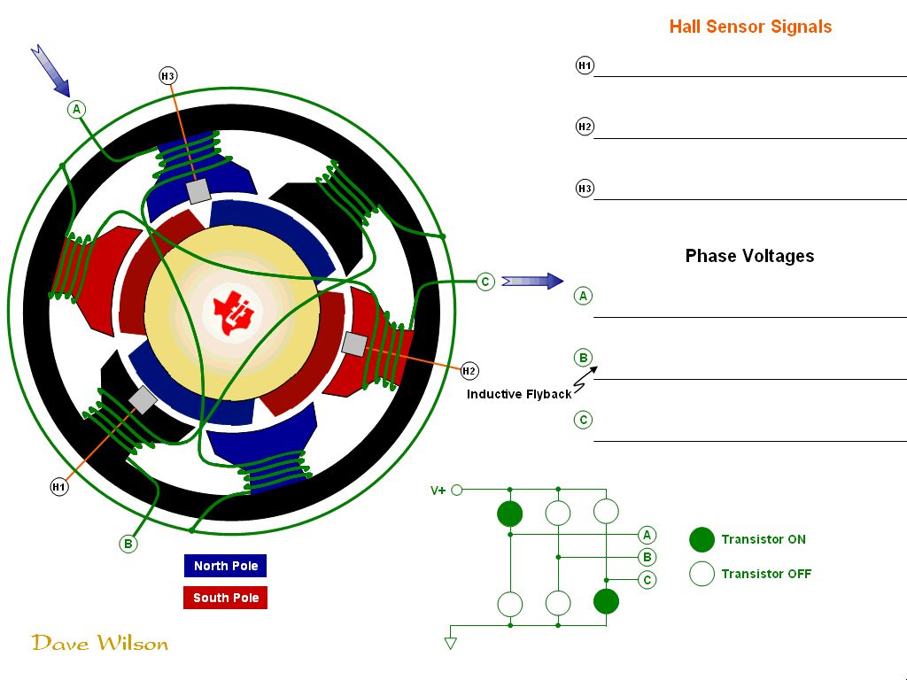

Slide 5
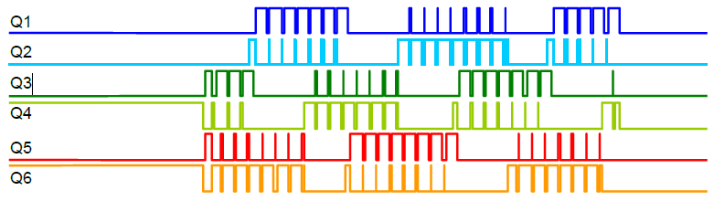
Actual Control Signals

Slide 6
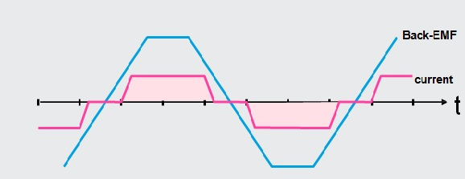
Control Basics
To run efficiently a BLDC motor, the current in each winding must be in phase with the b-emf induced in this same winding by the rotation of the magnet
If current and b-emf are not in phase, then the BLDC will not run efficiently or not run at all.

Slide 7
Rotor Position Detection
Controlling efficiently a BLDC requires to know the
position of the rotor at all times.
The are two ways to do it.
Hall Sensors
Sensorless control by using unenergized coils

Slide 8
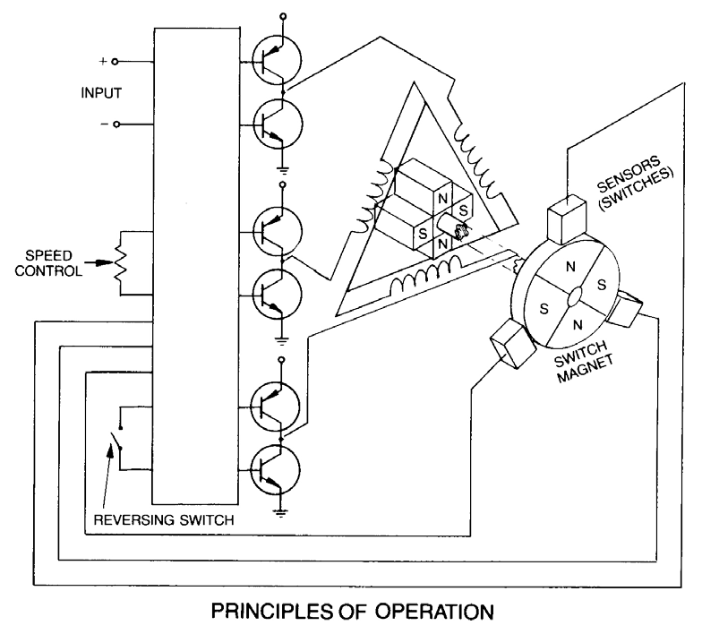
Speed control with hall sensors

Slide 9
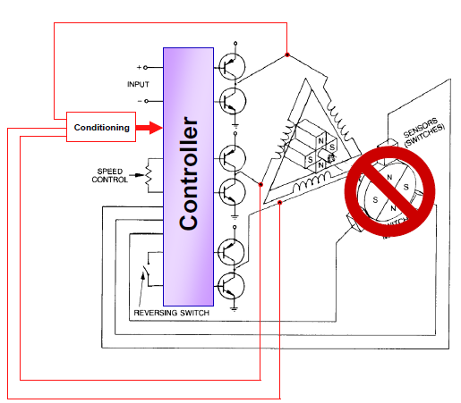
Sensorless Design

Slide 10
Sensorless Design
The only problem with the
sensorless design is since
the voltace induced by the
magnet is the proportion of
its speed, at low speed it is
hard to detect that signal

Slide 11
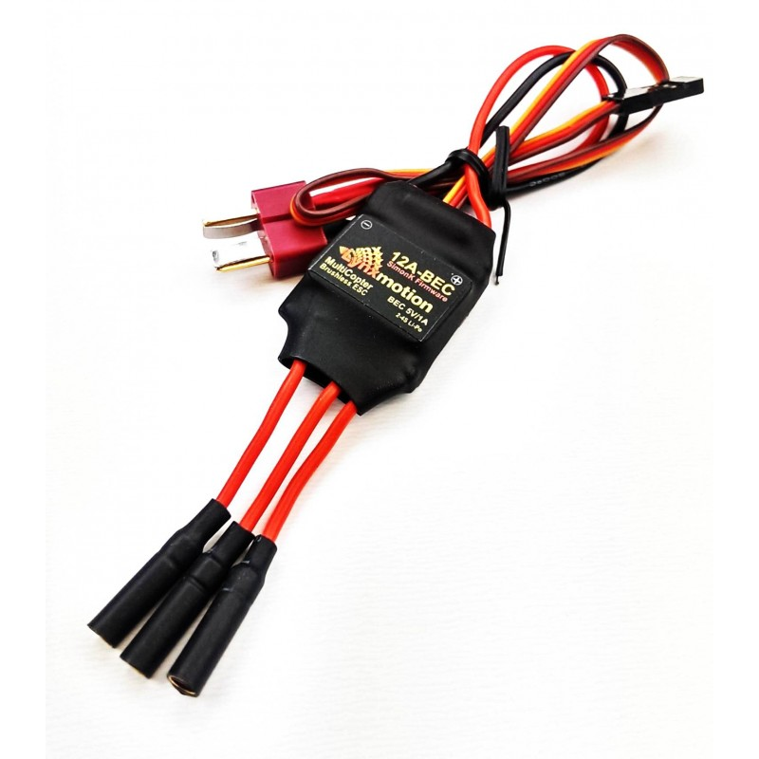
Is there an easy way to use a BLDC?
Yes, there is !!!
ESC = Electronic
Speed Controller

Slide 12
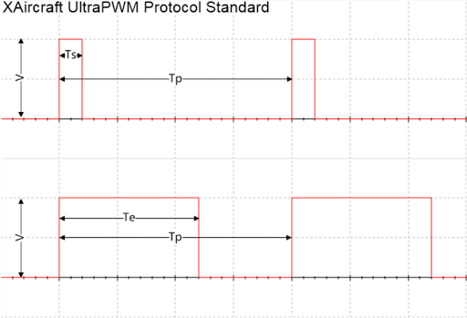
Speed Control with ESC
It is like controlling a hobby servo motor with PWM output.

Slide 13
Speed Control with ESC
Tp: The control cycle is 2ms(500Hz) Te : Start pulse width is 200us
Te: Termination pulse width is 1200us

Slide 14
Speed Control with ESC
Our control resolution is 1200-200 = 1000us mean 1000 control levels

Slide 15
Speed Control with ESC
Fro this particuler ESC, the brushless motor can not be start if pulse width less than 200us. Pulse width greater than 1200us is considered as the maximum motor output power

Slide 16
References
TI Motor Control Compendium 2010
http://e2e.ti.com/group/motor/m/files/default.aspx
Sensorless control of 3-phase brushless DC motors (Atmel application note)
http://www.rcgroups.com/forums/showthread.php?t=1317553

